Slide 1
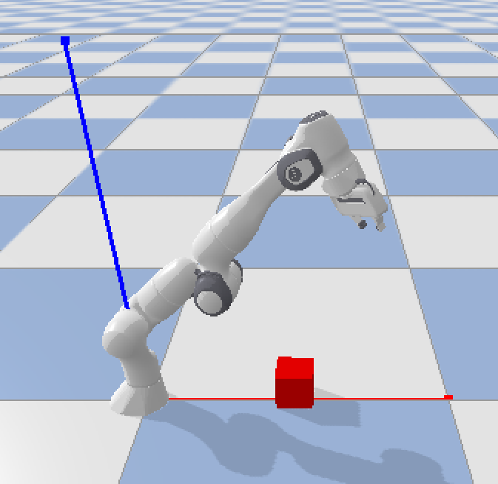
Steps of the demonstration (Team 4)
Laptop
/ROS2
Wireless Glove
Laptop
PyBullet Simulation
(Wifi)
(Manufacturer: HiWonder)
Robot Arm Model: Panda
(Manufacturer: Franka Emika GmbH)
Wireless Glove (Play time in video) | Robot Arm ‘Panda’ (PyBullet)
Extend only the index finger (00:00 – 00:20) | Log in to 1st Joint
(2) Make a fist (00:20 – 00:28) | When logging out from Joints 1 and 2, automatically log in to Joint 3.
(3) Extend the index and middle fingers (00:28 – 00:45) | Log in to 2nd Joint
(4) Make a fist (00:45 – 01:10), Log in to Joint 3 | When logging out from Joints 1 and 2, automatically log in to Joint 3.
(5) (When approaching the box within 0.2m, 01:10 – 01:30) Make a fist (01:30 – 01:35) | Close the gripper (Grid size: 1m x 1m)
(6) Fully open the hand (01:40 – 01:50) | Open the gripper
3rd Joint
Gripper
2nd Joint
* Initially, we attempted pitching and rolling while keeping one or two fingers extended. However, due to the high sensitivity of the sensor, achieving precise movements proved to be challenging. Consequently, to address this issue, we introduced a mechanism for individually logging in and out of each joint to control them separately. Furthermore, we minimized sudden movements by smoothing data using interpolation.
1st Joint

